Slide 1


React JS
(form handling)
Lecture-23

Slide 2
Today’s Agenda
Form Recap
How Forms Work In React ?
UnControlled Components V/s Controlled Components
Examples
Exercises

Slide 3
Why Forms ?
Forms are a crucial part of any web application.
They allow users to interact with our application as well as submit the relevant data required by the app.
For example : a login page , a registration page or even a billing page

Slide 4
Generating Forms In React
React has built-in support for forms, because HTML and the DOM have built-in support for forms.
And the main purpose of React is to simply render DOM nodes.
So adding Form to a React page , is almost same as we do in HTML.

Slide 5
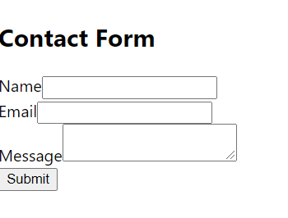
Generating Forms In React
import React, { Component } from "react";
class ContactForm extends Component {
render() {
return (
<form>
<h2>Contact Form</h2>
<div>
<label htmlFor="name">Name</label>
<input id="name" type="text" />
</div>
<div>
<label htmlFor="email">Email</label>
<input id="email" type="email" />
</div>
<div>
<label htmlFor="message">Message</label>
<textarea id="message" />
</div>
<button type="submit">Submit</button>
</form>
);
}
}
export default ContactForm;

Slide 6
Handling Forms In React
Form Handling means capturing the data when user inputs it or submits the form.
In React, to handle form we have two approaches :
Using UnControlled Components
Using Controlled Components

Slide 7
UnControlled Components
If we do nothing beyond dropping an <input> in our render() method, then that input will be uncontrolled.
We tell React to render the input, and the browser does the rest.

Slide 8
UnControlled Components
It’s the closest to a plain HTML input and requires less coding on our part
When we need to access the input’s value, we need to use Ref.
Uncontrolled inputs require less code, but make it harder to do certain things.

Slide 9
Controlled Components
With a controlled component , WE explicitly control the value that the input displays and will be handled in code by using event-based callbacks.
We have to write code to respond to keystrokes, store the current value somewhere, and pass that value back to the input to be displayed.

Slide 10
Controlled Components
In this case, the data is maintained in the state property and modified using setState().
This helps the component to easily manage the input elements and its data

Slide 11
Benefits Of
Controlled Components
Controlled inputs open up following possibilities:
Instant input validation: we can give the user instant feedback without having to wait for them to submit the form (e.g. if their password is not complex enough)
Instant input formatting: we can add proper separators to currency inputs, or grouping to phone numbers on the fly
Conditionally disable form submission: we can enable the submit button after certain criteria are met (e.g. the user consented to the terms and conditions)
Dynamically generate new inputs: we can add additional inputs to a form based on the user’s previous input (e.g. adding details of additional people on a hotel booking)

Slide 12
How To Create A
Controlled Component ?
To create a Controlled Component we take four steps:
Create a key in state object for representing input field’s value
Create a Form with an input field in the render() method and set the value of input field to corresponding key in the state object
Also in the onChange event of the input field set an event handler
Write code in the event handler to update the state with input field’s value as soon as the user presses a key

Slide 13
Exercise
Create a Form Based App which displays a textbox for inputting username and soon as the user types his/her name in the textbox , it should be reflected on the page

Slide 14
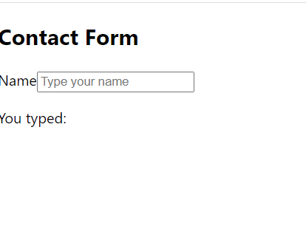
Desired Output

Slide 15
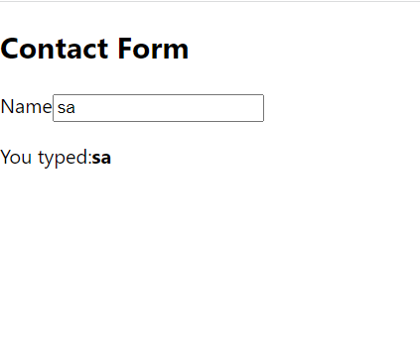
Desired Output

Slide 16
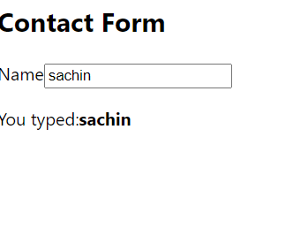
Desired Output

Slide 17
Solution
ContactForm.js
import React, { Component } from "react";
class ContactForm extends Component {
constructor(props) {
super(props);
this.state = { username: "" };
this.handleChange = this.handleChange.bind(this);
}
handleChange(evt) {
this.setState({ username: evt.target.value });
}
render() {
return (
<div>
<h2>Contact Form</h2>
<form>
<label htmlFor="name">Name</label>
<input
type="text"
placeholder="Type your name"
value={this.state.username}
onChange={this.handleChange}
/>
</form>
<p>
You typed:<b>{this.state.username}</b>
</p>
</div>
);
}
}
export default ContactForm;

Slide 18
Solution
App.js
import React, { Component } from "react";
import ContactForm from "./ContactForm";
class App extends Component {
render() {
return (
<div>
<ContactForm />
</div>
);
}
}
export default App;

Slide 19
Submitting The Form
When Submit button is clicked, the browser performs a default form submission by making a full-page GET/POST request to the URL specified in the action attribute of the <form>.
If not specified, the action attribute equals the current URL.
But, since the form is controlled by React, we don’t want this to happen.

Slide 20
Submitting The Form
To prevent the browser from performing the default action on submit, simply attach an onSubmit event handler to the form, then call event.preventDefault().
Moreover, inside the onSubmit event handler we can perform a POST request by ourself to save the user form.

Slide 21
Exercise
Modify the previous App so that now after typing the text if the user strikes ENTER key or clicks on the submit button then two things should happen:
The text should appear in alert
The input field must be cleared
Make sure to cancel the browser’s default action of form submission

Slide 22
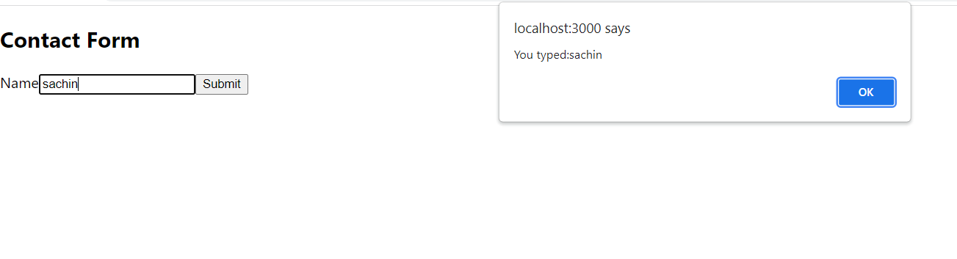
Desired Output

Slide 23
Solution
ContactForm.js
import React, { Component } from "react";
class ContactForm extends Component {
constructor(props) {
super(props);
this.state = { username: "" };
this.handleChange = this.handleChange.bind(this);
this.handleSubmit = this.handleSubmit.bind(this);
}
handleChange(evt) {
this.setState({ username: evt.target.value });
}
handleSubmit(evt) {
evt.preventDefault();
alert("You typed:" + this.state.username);
this.setState({ username: "" });
}

Slide 24
Solution
ContactForm.js
render() {
return (
<div>
<h2>Contact Form</h2>
<form onSubmit={this.handleSubmit}>
<label htmlFor="name">Name</label>
<input
type="text"
placeholder="Type your name"
value={this.state.username}
onChange={this.handleChange}
/>
<button>Submit</button>
</form>
</div>
);
}
}
export default ContactForm;

Slide 25
Solution
App.js
import React, { Component } from "react";
import ContactForm from "./ContactForm";
class App extends Component {
render() {
return (
<div>
<ContactForm />
</div>
);
}
}
export default App;

Slide 26
Exercise
Again modify the previous App so that now instead of alert the text should appear on the page itself , but only when after typing the text if the user strikes ENTER key or clicks on the submit button.

